Slide 1
Module 4: R2P in Practice –
Responding to the Threat of Mass Atrocity Crimes
GLOBAL CENTRE FOR THE RESPONSIBILITY TO PROTECT

Slide 2
Phase 2 – Analysis
GLOBAL CENTRE FOR THE RESPONSIBILITY TO PROTECT
Analyze
Monitor
Identify
Treat
Module 4: R2P in Practice – Responding to the Threat of Mass Atrocity Crimes
1

Slide 3
Phase 2 – Analysis: Articulating the Risk
GLOBAL CENTRE FOR THE RESPONSIBILITY TO PROTECT
  Example (daily life): IF it is raining, THEN I will get wet.
  Examples (conflict context):
  IF hate speech continues in South Sudan, THEN targeted killings may increase.
  IF security forces are not trained in respect for human rights, THEN they may use unnecessary force against civilians and perpetrate arbitrary arrests.
Module 4: R2P in Practice – Responding to the Threat of Mass Atrocity Crimes
2

Slide 4
Phase 2 – Analysis: Risk Likelihood
GLOBAL CENTRE FOR THE RESPONSIBILITY TO PROTECT
  Risk likelihood:
  5. Near certainty
  4. Likely
  3. Possible
  2. Fairly unlikely
  1. Remote
Module 4: R2P in Practice – Responding to the Threat of Mass Atrocity Crimes
3

Slide 5
Phase 2 – Analysis: Risk Likelihood
GLOBAL CENTRE FOR THE RESPONSIBILITY TO PROTECT
  IF land for farming and grazing is scare, the rainy season has just ended, and agricultural and herder communities have a history of inter-communal violence, THEN fighting may break out.
  IF fighting breaks out, THEN civilians may be targeted based upon their religious identity.
  IF fighting breaks out, THEN children may be abducted.
  IF fighting breaks out, THEN villages and property may be intentionally destroyed.
  IF fighting breaks out, THEN a particular group may be massacred in retaliatory attacks.
Module 4: R2P in Practice – Responding to the Threat of Mass Atrocity Crimes
4

Slide 6
Phase 2 – Analysis: Risk Impact
GLOBAL CENTRE FOR THE RESPONSIBILITY TO PROTECT
  Risk impact:
  5. Severe unbearable impact
  4. High impact
  3. Medium impact
  2. Moderate impact
  1. Bearable impact
Module 4: R2P in Practice – Responding to the Threat of Mass Atrocity Crimes
5

Slide 7
Phase 2 – Analysis: Scoring the Risk
GLOBAL CENTRE FOR THE RESPONSIBILITY TO PROTECT
  Risk likelihood x Risk impact = Risk score
  Example: IF hate speech continues in South Sudan, THEN targeted killings may increase.
  Risk likelihood: 3 x Risk impact: 4 = Risk score: 12
Module 4: R2P in Practice – Responding to the Threat of Mass Atrocity Crimes
6

Slide 8
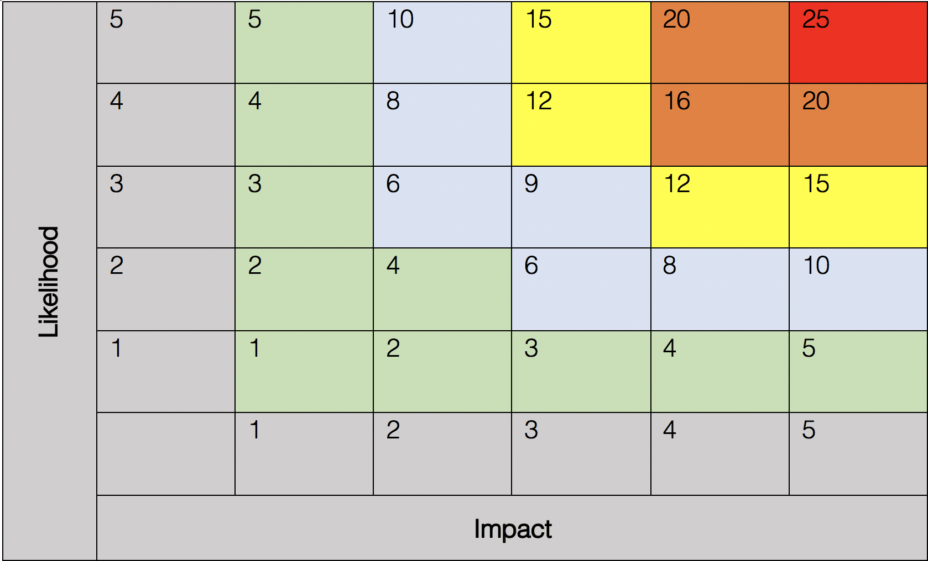
Phase 2 – Analysis: Prioritizing
GLOBAL CENTRE FOR THE RESPONSIBILITY TO PROTECT
R3
R5
R2
R1
R4
Module 4: R2P in Practice – Responding to the Threat of Mass Atrocity Crimes
7

Slide 9
Module 4 Activity:
Conducting a risk assessment
GLOBAL CENTRE FOR THE RESPONSIBILITY TO PROTECT
Module 4: R2P in Practice – Responding to the Threat of Mass Atrocity Crimes
8

Slide 10
Phase 3 – Treatment
GLOBAL CENTRE FOR THE RESPONSIBILITY TO PROTECT
Analyze
Monitor
Identify
Treat
Module 4: R2P in Practice – Responding to the Threat of Mass Atrocity Crimes
9

Slide 11
Phase 3 – Treatment
GLOBAL CENTRE FOR THE RESPONSIBILITY TO PROTECT
  Three options for risk treatment:
  Transfer (to another actor, entity)
  Mitigate: consider how to mitigate, the resources needed and key actors involved
  Accept
Module 4: R2P in Practice – Responding to the Threat of Mass Atrocity Crimes
10

Slide 12
Possible options for “transfer” within mission:
GLOBAL CENTRE FOR THE RESPONSIBILITY TO PROTECT
Civil Affairs
Political Affairs
Rule of Law/Judicial Affairs
SSR
DDR
JOC/JMAC
Public Information
Mission Support
DSRSG/RC/HC
SRSG’s Office
Women Protection Advisers
Child Protection Advisers
Gender Advisers
Module 4: R2P in Practice – Responding to the Threat of Mass Atrocity Crimes
11

Slide 13
Possible options for “transfer” outside the mission:
GLOBAL CENTRE FOR THE RESPONSIBILITY TO PROTECT
Host State
Neighboring States
Other UN Actors and Agencies
  UN Security Council
  UNHCR
  OHCHR
  UNICEF
  OCHA
Regional Organizations
Non-State Actors
  ICRC
  Local Civil Society
Module 4: R2P in Practice – Responding to the Threat of Mass Atrocity Crimes
12

Slide 14
Phase 4 – Monitor
GLOBAL CENTRE FOR THE RESPONSIBILITY TO PROTECT
Analyze
Monitor
Identify
Treat
Module 4: R2P in Practice – Responding to the Threat of Mass Atrocity Crimes
13

Slide 15
Module 4 Activity:
Developing tactical responses to risks
GLOBAL CENTRE FOR THE RESPONSIBILITY TO PROTECT
Module 4: R2P in Practice – Responding to the Threat of Mass Atrocity Crimes
14

Slide 16
Options for Tactical Response
GLOBAL CENTRE FOR THE RESPONSIBILITY TO PROTECT
  Patrols
  Conduct joint operations that include military/UNPOL personnel as well as national police/host military forces
  Evacuation of civilians under threat
  Conduct cordon and search operations
  Mobilize quick/rapid reaction forces
  Neutralize/defeat forces that threaten civilians
  Support relief for displaced populations
  Support the provision of humanitarian assistance
  Civilian asset protection
Module 4: R2P in Practice – Responding to the Threat of Mass Atrocity Crimes
15

Slide 17
GLOBAL CENTRE FOR THE RESPONSIBILITY TO PROTECT
Addressing the Specific Vulnerabilities of Women and Children
    Protection and Response Tasks:
      Tailor patrols to women and children’s mobility patterns
      Ensure that women have access to information and services provided by the mission
      Support the Protection of Children
      Support the Elimination of Conflict-Related Sexual Violence
      Intervene to stop sexual violence from happening when you have early warning information and detain perpetrators whenever possible
      Establish safe areas for women and children within IDP camps/Protection of Civilian Sites
      Involve women peacekeeping personnel in cordon and search activities within communities and protection sites
      Some mission staff are mandated to negotiate action plans on children with armed groups in order to facilitate the return of children and/or deter groups from further recruitment
Module 4: R2P in Practice – Responding to the Threat of Mass Atrocity Crimes
16

Slide 18
Consolidation and Preventing Recurrence
GLOBAL CENTRE FOR THE RESPONSIBILITY TO PROTECT
    Disarmament, Demobilization and Reintegration of armed groups
    Security Sector Reform
    Inter-communal dialogue and education programs
    Facilitating the peace process, including supporting the creation of reconciliation programs and transitional justice mechanisms, as well as participation in ceasefire monitoring
    Quick impact projects
    Support the restoration and protection of cultural heritage
Module 4: R2P in Practice – Responding to the Threat of Mass Atrocity Crimes
17

Slide 19
Module 4 Learning Outcomes - Review
GLOBAL CENTRE FOR THE RESPONSIBILITY TO PROTECT
By the end of Module 4, learners will:
Articulate where R2P and the Atrocity Prevention Lens apply within the day-to-day work of UN peacekeepers
Identify, prioritize and formulate a tactical and strategic plan to mitigate risks of atrocity crimes
Module 4: R2P in Practice – Responding to the Threat of Mass Atrocity Crimes
18

