Slide 1
GLOBAL CENTRE FOR THE RESPONSIBILITY TO PROTECT
Module 2: Why is R2P a Useful Lens for Peacekeepers?

Slide 2
Module 1 Review: Definition of R2P
GLOBAL CENTRE FOR THE RESPONSIBILITY TO PROTECT
2
Module 2: Why is R2P a Useful Lens for Peacekeepers?

Slide 3
Discussion Question: How is the Protection of Civilians defined in the context of UN peacekeeping?
GLOBAL CENTRE FOR THE RESPONSIBILITY TO PROTECT
3
Module 2: Why is R2P a Useful Lens for Peacekeepers?

Slide 4
Definition Protection of Civilians
GLOBAL CENTRE FOR THE RESPONSIBILITY TO PROTECT
Based on the language used by the UN Security Council in POC mandates, the physical protection of civilians in UN peacekeeping can be defined as:
“all necessary action, up to and including the use of force, aimed at preventing or responding to threats of physical violence against civilians, within capabilities and areas of operations, and without prejudice to the responsibility of the host government to protect its civilians.”
4
Module 2: Why is R2P a Useful Lens for Peacekeepers?

Slide 5
POC Guiding Principles
GLOBAL CENTRE FOR THE RESPONSIBILITY TO PROTECT
Primary responsibility of the state
Grounded in international law
A whole of mission activity
A priority mandate
Cooperation with humanitarian actors
Obligation of peacekeeping personnel
Community-based approach
An active duty to protect
Consonant with the principles of peacekeeping
Gender perspective and child protection concerns
5
Module 2: Why is R2P a Useful Lens for Peacekeepers?

Slide 6
Defining threats under POC:
GLOBAL CENTRE FOR THE RESPONSIBILITY TO PROTECT
“Any impending or potential physical violence against civilians.” This includes:
Threats to life
Threats to physical integrity
Threats to freedom
Threats to property
6
Module 2: Why is R2P a Useful Lens for Peacekeepers?

Slide 7
Three Tiers of Protection
GLOBAL CENTRE FOR THE RESPONSIBILITY TO PROTECT
Tier 1: Protection through dialogue and engagement (including conflict resolution and mediation, dialogue with potential perpetrators, etc.)
Tier 2: Provision of physical protection (including military and police activities to show or use force to prevent, deter, and respond to civilians under threat of physical violence.)
Tier 3: Establishment of a protective environment (including programmatic activities with medium and long-term peacebuilding objectives.)
7
Module 2: Why is R2P a Useful Lens for Peacekeepers?

Slide 8
Responding to Threats to Populations
GLOBAL CENTRE FOR THE RESPONSIBILITY TO PROTECT
The UN’s Protection of Civilians policy includes responses across four phases:
Prevention
Pre-emption
Response
Consolidation
8
Module 2: Why is R2P a Useful Lens for Peacekeepers?

Slide 9
GLOBAL CENTRE FOR THE RESPONSIBILITY TO PROTECT
Module 2 Activity: R2P AND POC – DIFFERENCES AND SIMILARITIES
9
Module 2: Why is R2P a Useful Lens for Peacekeepers?

Slide 10
Addressing gaps in UN capacity to protect civilians
GLOBAL CENTRE FOR THE RESPONSIBILITY TO PROTECT
High-Level Independent Panel on Peace Operations (HIPPO) (2015)
Kigali Principles on the Protection of Civilians (2015)
Independent Special Investigation into the violence which occurred in Juba in 2016 and UNMISS response (The “Cammaert Report”) (2016)
Report on Improving the Security of Peacekeepers (The “Cruz Report”) (2017)
Module 2: Why is R2P a Useful Lens for Peacekeepers?
10

Slide 11
High-Level Independent Panel on Peace Operations
GLOBAL CENTRE FOR THE RESPONSIBILITY TO PROTECT
The HIPPO contributed to a generational review of peacekeeping. The panel’s final report put forward four recommendations for improving peacekeeping and the protection of civilians.
Primacy of politics
Responsive operations and tailored responses
Stronger partnerships
Field-focused and people-centered approaches
Module 2: Why is R2P a Useful Lens for Peacekeepers?
11

Slide 12
Kigali Principles on the Protection of Civilians
GLOBAL CENTRE FOR THE RESPONSIBILITY TO PROTECT
Set of 18 pledges aimed at the effective implementation of POC in peacekeeping missions.
As of 2018, 47 UN member states have endorsed the Principles
The Principles include such pledges as:
“To train all of our troops on the protection of civilians prior to their deployment to missions.”
“Not to hesitate to take action to protect civilians, in accordance with the rules of engagement, in the absence of an effective host government response or demonstrated willingness to carry out its responsibilities to protect civilians.”
“To seek to identify, as early as possible, potential threats to civilians and proactively take steps to mitigate such threats and otherwise reduce the vulnerability of the civilian population.“
12
Module 2: Why is R2P a Useful Lens for Peacekeepers?

Slide 13
“Cammaert Report”
GLOBAL CENTRE FOR THE RESPONSIBILITY TO PROTECT
The report investigates an incident in South Sudan during July 2016 when peacekeepers failed to provide protection to civilians when violence broke out in the capital
Major gaps addressed in the Report:
Reporting in “silos” vs. consolidated analysis
Decision-making by mission leadership
“Accountability for Protection”
Module 2: Why is R2P a Useful Lens for Peacekeepers?
13

Slide 14
“Cruz Report”
GLOBAL CENTRE FOR THE RESPONSIBILITY TO PROTECT
Commissioned in 2017 in response to an increasing number of peacekeepers killed in “malicious acts” in the field
Highlights gaps in both force protection and civilian protection
Focuses on the changing nature of the threat faced by civilians and by peacekeepers in today’s operating environments
Recommendations include:
Consolidated situational awareness
Better pre-deployment training
More mobile forces with quick reaction capacity
Module 2: Why is R2P a Useful Lens for Peacekeepers?
14

Slide 15
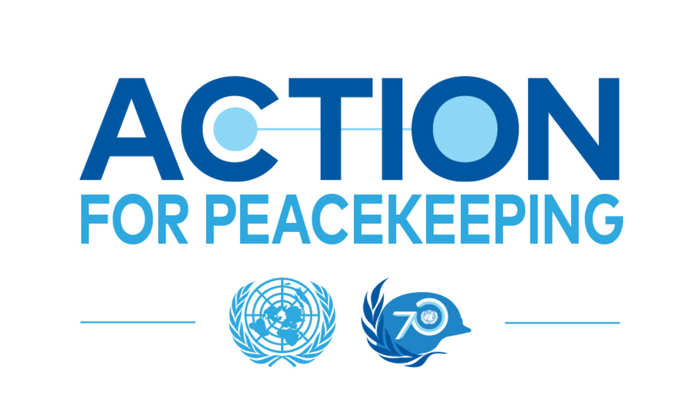
Action for Peacekeeping (A4P)
GLOBAL CENTRE FOR THE RESPONSIBILITY TO PROTECT
In 2018 the UN Secretary-General and member states developed a set of mutually-agreed principles and commitments to ensure peacekeeping operations are fit for the future
This “Declaration of Shared Commitments” currently endorsed by 150 states and 4 regional organizations
Principles are centered around 5 main themes:
Peacebuilding
Performance
People
Partnerships
Politics
Module 2: Why is R2P a Useful Lens for Peacekeepers?
15

Slide 16
How can R2P and the Atrocity Prevention Lens aid in overcoming gaps identified in these reports?
GLOBAL CENTRE FOR THE RESPONSIBILITY TO PROTECT
Module 2: Why is R2P a Useful Lens for Peacekeepers?
16

Slide 17
Added Value of R2P to POC and Peacekeeping
GLOBAL CENTRE FOR THE RESPONSIBILITY TO PROTECT
Understanding the nature of the threat
Identifying the patterns that lead to crimes
Triggering early action
Module 2: Why is R2P a Useful Lens for Peacekeepers?
17

Slide 18
What is Risk Management?
GLOBAL CENTRE FOR THE RESPONSIBILITY TO PROTECT
Risk management entails identifying, evaluating and prioritizing threats.
“Risk” is the likelihood of a threat occurring as a result of vulnerabilities
Risk assessments analyze:
Potential/actual threats (based on threat assessments)
Likelihood of the threat occurring
The potential impact it may have
Potential responses (transfer, mitigate or accept)
Module 2: Why is R2P a Useful Lens for Peacekeepers?
18

Slide 19
Four Phases of the Risk Management Cycle
GLOBAL CENTRE FOR THE RESPONSIBILITY TO PROTECT
Analyze
Monitor
Identify
Treat
Module 2: Why is R2P a Useful Lens for Peacekeepers?
19

Slide 20
Phase 1 – Risk Identification
GLOBAL CENTRE FOR THE RESPONSIBILITY TO PROTECT
Analyze
Monitor
Identify
Treat
Module 2: Why is R2P a Useful Lens for Peacekeepers?
20

Slide 21
Defining Threats Under POC:
GLOBAL CENTRE FOR THE RESPONSIBILITY TO PROTECT
“Any impending or potential physical violence against civilians.”
This includes:
Threats to life
Threats to physical integrity
Threats to freedom
Threats to property
Module 2: Why is R2P a Useful Lens for Peacekeepers?
21

Slide 22
Understanding the Nature of Threats
GLOBAL CENTRE FOR THE RESPONSIBILITY TO PROTECT
Systemic threats
Political
Societal
Environmental
Triggering events
Conflict dynamics
Module 2: Why is R2P a Useful Lens for Peacekeepers?
22

Slide 23
Added Value of R2P to POC in Peacekeeping
GLOBAL CENTRE FOR THE RESPONSIBILITY TO PROTECT
Understanding the nature of the threat
Identifying the patterns that lead to crimes
Triggering early action
Module 2: Why is R2P a Useful Lens for Peacekeepers?
23

Slide 24
GLOBAL CENTRE FOR THE RESPONSIBILITY TO PROTECT
24
Module 2: Why is R2P a Useful Lens for Peacekeepers?

Slide 25
Module 2 Activity: Understanding the nature of threats
GLOBAL CENTRE FOR THE RESPONSIBILITY TO PROTECT
Module 2: Why is R2P a Useful Lens for Peacekeepers?
25

Slide 26
Module 2 Learning Outcomes - Review
GLOBAL CENTRE FOR THE RESPONSIBILITY TO PROTECT
By the end of Module 2, learners will:
Understand the relationship between R2P and POC
Understand existing gaps in UN peacekeeping and civilian protection
Discuss ways in which using R2P and the Atrocity Prevention Lens can add value to existing POC activities
Understand how an Atrocity Prevention Lens enhances other protection agendas like Child Protection, CRSV and protection of cultural heritage
26
Module 2: Why is R2P a Useful Lens for Peacekeepers?

