Slide 1
Paragraphs 138-139 of the World Summit Outcome Document
GLOBAL CENTRE FOR THE RESPONSIBILITY TO PROTECT
138. Each individual State has the responsibility to protect its populations from genocide, war crimes, ethnic cleansing and crimes against humanity. This responsibility entails the prevention of such crimes, including their incitement, through appropriate and necessary means. We accept that responsibility and will act in accordance with it. The international community should, as appropriate, encourage and help States to exercise this responsibility and support the United Nations in establishing an early warning capability.
1
Module 1: What is the “Responsibility to Protect?”

Slide 2
Paragraphs 138-139 of the World Summit Outcome Document
GLOBAL CENTRE FOR THE RESPONSIBILITY TO PROTECT
139. The international community, through the United Nations, also has the responsibility to use appropriate diplomatic, humanitarian and other peaceful means, in accordance with Chapters VI and VIII of the Charter, to help protect populations from genocide, war crimes, ethnic cleansing and crimes against humanity. In this context, we are prepared to take collective action, in a timely and decisive manner, through the Security Council, in accordance with the Charter, including Chapter VII, on a case-by-case basis and in cooperation with relevant regional organizations as appropriate, should peaceful means be inadequate and national authorities manifestly fail to protect their populations from genocide, war crimes, ethnic cleansing and crimes against humanity. We stress the need for the General Assembly to continue consideration of the responsibility to protect populations from genocide, war crimes, ethnic cleansing and crimes against humanity and its implications, bearing in mind the principles of the Charter and international law. We also intend to commit ourselves, as necessary and appropriate, to helping States build capacity to protect their populations from genocide, war crimes, ethnic cleansing and crimes against humanity and to assisting those which are under stress before crises and conflicts break out.
2
Module 1: What is the “Responsibility to Protect?”

Slide 3
GLOBAL CENTRE FOR THE RESPONSIBILITY TO PROTECT
The Responsibility to Protect (R2P) is a political commitment made by states affirming their responsibility to protect populations from four mass atrocity crimes:
    Genocide
    War crimes
    Crimes against humanity
    Ethnic cleansing
3
Module 1: What is the “Responsibility to Protect?”

Slide 4
R2P’s Three Pillars
GLOBAL CENTRE FOR THE RESPONSIBILITY TO PROTECT
Pillar 1: Every state has the primary responsibility to protect their populations from genocide, war crimes, ethnic cleansing and crimes against humanity;
Pillar 2: The international community has the responsibility to encourage and provide assistance to individual states in building capacity to meet that responsibility;
Pillar 3: If a state is manifestly failing to protect its populations, the international community must be preprared to take appropriate collective action, in a timely and decisive manner and in accordance with the UN Charter.
4
Module 1: What is the “Responsibility to Protect?”

Slide 5
Activity: In-And-Out
GLOBAL CENTRE FOR THE RESPONSIBILITY TO PROTECT
5
Module 1: What is the “Responsibility to Protect?”

Slide 6
Definition of the Crimes: Genocide
GLOBAL CENTRE FOR THE RESPONSIBILITY TO PROTECT
“acts committed in a deliberate attempt to destroy in whole or in part a national, ethnic, racial or religious group”
This includes such acts as:
  Killing members of the group
  Causing serious bodily or mental harm to members of the group
  Deliberately inflicting on the group conditions of life calculated to bring about its physical destruction in whole or in part
  Imposing measures intended to prevent births within the group
6
Module 1: What is the “Responsibility to Protect?”

Slide 7
War Crimes
GLOBAL CENTRE FOR THE RESPONSIBILITY TO PROTECT
“acts which constitute grave breaches and other violations of the laws and customs of armed conflict, particularly those in violation of the Geneva Conventions”
This includes such acts as:
  Intentionally directing attacks against the civilian population as such or against individual civilians not taking direct part in hostilities
  Attacking or bombarding, by whatever means, towns, villages, dwellings or buildings which are undefended and which are not military objectives
  Employing poison or poisoned weapons
7
Module 1: What is the “Responsibility to Protect?”

Slide 8
Crimes Against Humanity
GLOBAL CENTRE FOR THE RESPONSIBILITY TO PROTECT
“acts committed as part of a widespread or systematic attack directed against a civilian population”
This includes such acts as:
  Murder
  Torture
  Enslavement
  Forcible transfers of populations
  Rape and sexual violence
  Persecution
8
Module 1: What is the “Responsibility to Protect?”

Slide 9
Ethnic cleansing
GLOBAL CENTRE FOR THE RESPONSIBILITY TO PROTECT
No formal legal definition; ethnic cleansing involves the systematic forced removal of distinct minority groups from a given territory, often with the intent of making it ethnically homogeneous.
This includes such acts as:
  Forced migration (deportation, population transfer)
  Intimidation
  Mass murder
9
Module 1: What is the “Responsibility to Protect?”

Slide 10
Activity: Identification of Crimes
GLOBAL CENTRE FOR THE RESPONSIBILITY TO PROTECT
Module 1: What is the “Responsibility to Protect?”
10

Slide 11
Guinea
GLOBAL CENTRE FOR THE RESPONSIBILITY TO PROTECT
During December 2008 the military in Guinea staged a coup, forming a junta government.
The leader of the junta, Captain Moussa Dadis Camara, pledged to abstain from running for president during the country’s January 2010 elections.
During 2009 Camara broke his pledge, declaring his candidacy for the presidential race.
This prompted opposition protests, which were banned in Guinea.
On 28 September 2009 the opposition held a pro-democracy rally at a stadium in Conakry. During the rally hundreds of members of the government security forces entered the stadium and opened fire on the crowd. Other members of the security forces blocked the gates to prevent civilians from fleeing.
At least 150 people were killed and over 1,200 were seriously injured. There were reports of security forces perpetrating rape and other forms of sexual violence targeting women and girls in the crowd. Groups of men were also arbitrarily detained by security forces.
Module 1: What is the “Responsibility to Protect?”
11

Slide 12
Catalonia (Spain)
GLOBAL CENTRE FOR THE RESPONSIBILITY TO PROTECT
During 2017 the autonomous Spanish region of Catalonia scheduled a referendum to vote on whether there was popular support for gaining independence from Spain.
The Spanish government declared the vote illegal on 7 September and the Constitutional Court suspended the referendum.
Despite this, a referendum was held on 1 October.
Prior to the referendum, the government tried to block the vote by disabling internet, confiscating ballots and threatening to detain Catalonian officials.
On the day of the vote, the government sent the National Police and Guardia Civil to block the vote and prevent people from entering polling stations.
Violence broke out between civilians and the security forces, with reports of police using rubber bullets, hitting people with batons and physically dragging them from polling stations. Catalonian officials were threatened with arrest.
At least 900 civilians and 30 security agents were injured.
Module 1: What is the “Responsibility to Protect?”
12

Slide 13
Yemen
GLOBAL CENTRE FOR THE RESPONSIBILITY TO PROTECT
During 2014 the Houthis, an armed movement originating in northeast Yemen, and military units loyal to deposed President Ali Abdullah Saleh, took control of numerous governorates across the country.
In March 2015 a Saudi Arabia-led military coalition responded to a government request for regional military intervention. Fighting between the Houthis and the government – supported by the military coalition – remains ongoing.
On 1 November 2017 an airstrike by the Saudi-led coalition targeted a hotel and adjoining market in Houthi-controlled Sa’ada province, resulting in the death of at least 31 civilians.
The market and hotel are reportedly not within the vicinity of any Houthi military sites, and there is no clear evidence that Houthi fighters were killed in the strike.
The Saudi-led coalition has routinely targeted non-military sites in their airstrikes.
13
Module 1: What is the “Responsibility to Protect?”

Slide 14
Myanmar
GLOBAL CENTRE FOR THE RESPONSIBILITY TO PROTECT
The Rohingya, a Muslim minority group, have faced institutionalized discrimination in Myanmar for decades.
Myanmar's security forces have carried out "clearance operations" in Rakhine State since 25 August 2017 after an armed group calling itself the Arakan Rohingya Salvation Army (ARSA) attacked police posts and an army base.
Since that date there have been widespread reports of the security forces imposing collective punishment upon the ethnic Rohingya community, including the unlawful killing of civilians, mass displacement, rape, and the burning of at least 400 villages.
At least 720,000 refugees – mostly Rohingya – have fled across the border to escape violence, bringing the total number of Rohingya refugees in Bangladesh to more than 900,000.
Myanmar's authorities seized Rohingya land across Rakhine State. Local government officials have indicated that confiscated land will now be reclassified for other purposes, and that Rohingya refugees will not necessarily be allowed to return to their previous villages.
Module 1: What is the “Responsibility to Protect?”
14

Slide 15
Iraq
GLOBAL CENTRE FOR THE RESPONSIBILITY TO PROTECT
Between October 2016 and July 2017 the Iraqi Security Forces (ISF) conducted a military offensive to recapture the city of Mosul from the so-called Islamic State of Iraq and the Levant (ISIL).
A United States-led military coalition lent significant air support to the Iraqi government during the offensive.
Throughout the offensive, the UN received credible reports of ISIL forcibly displacing civilians and using civilians as human shields.
On 17 March an airstrike on a building in the al-Jadidah district of Mosul, in which ISIL snipers were situated, led to the deaths of up to 200 civilians. The airstrike and civilian deaths were subsequently confirmed by a US military investigation
Investigations indicate that the airstrike had triggered explosives placed in the building by ISIL fighters, causing it to collapse. According the US investigation and the ISF, it was unknown that the building had been rigged with explosives.
Module 1: What is the “Responsibility to Protect?”
15

Slide 16
Who has a Responsibility to Protect?
GLOBAL CENTRE FOR THE RESPONSIBILITY TO PROTECT
States (leaders and policy makers, judiciary, security sector, national human rights institutions, etc.)
Regional and sub-regional organizations (eg. African Union, European Union, Economic Community of West African States)
International organizations (including the UN and its various entities such as the Security Council, General Assembly, and Office of the High Commissioner for Human Rights, Department of Peacekeeping Operations, etc.)
  The UN Security Council has a special responsibility under Pillar III due to its responsibility to maintain international peace and security under the UN Charter
16
Module 1: What is the “Responsibility to Protect?”

Slide 17
Pillar I
GLOBAL CENTRE FOR THE RESPONSIBILITY TO PROTECT
  Protecting human rights and minority rights through constitutional and other legal protections
  Ensuring the responsiveness of the security sector
  Providing access to justice
  Creating conditions for the equitable distribution of resources
  Establishing laws against hate speech and hate crimes
  Providing education curriculum that does not privilege one group over another
  Memorializing and acknowledging past crimes
  Ratifying and upholding international treaties that protect rights
17
Module 1: What is the “Responsibility to Protect?”

Slide 18
Pillar II
GLOBAL CENTRE FOR THE RESPONSIBILITY TO PROTECT
Financial, logistical, and economic assistance to a state to build the capacity of the government to fulfill its Pillar I commitments
Development assistance
Capacity building assistance for government institutions and programs
Assistance to build the capacity of and reform the security sector
Establishment of hybrid courts for transitional justice
Denying the means to commit atrocities
18
Module 1: What is the “Responsibility to Protect”?

Slide 19
GLOBAL CENTRE FOR THE RESPONSIBILITY TO PROTECT
Pillar III
Actions taken to prevent and halt atrocity crimes including:
  Use of UN Secretary-General’s and his representatives’ good offices
  Diplomacy
  Mediation
  Targeted sanctions
  ICC referral
  Arms embargoes
  Establishing no-fly zones
  Deployment of troops
  Deployment of peacekeeping missions
  Authorization of human rights monitors to collect information on crimes
  Establishment of or providing support to international tribunals
19
Module 1: What is the “Responsibility to Protect?”

Slide 20
GLOBAL CENTRE FOR THE RESPONSIBILITY TO PROTECT
GLOBAL CENTRE FOR THE RESPONSIBILITY TO PROTECT
Principal Organs of the United Nations System
Security Council
General Assembly
Economic and Social Council
International Court of Justice
Trusteeship Council
Secretariat
Module 1: What is the “Responsibility to Protect?”
20

Slide 21
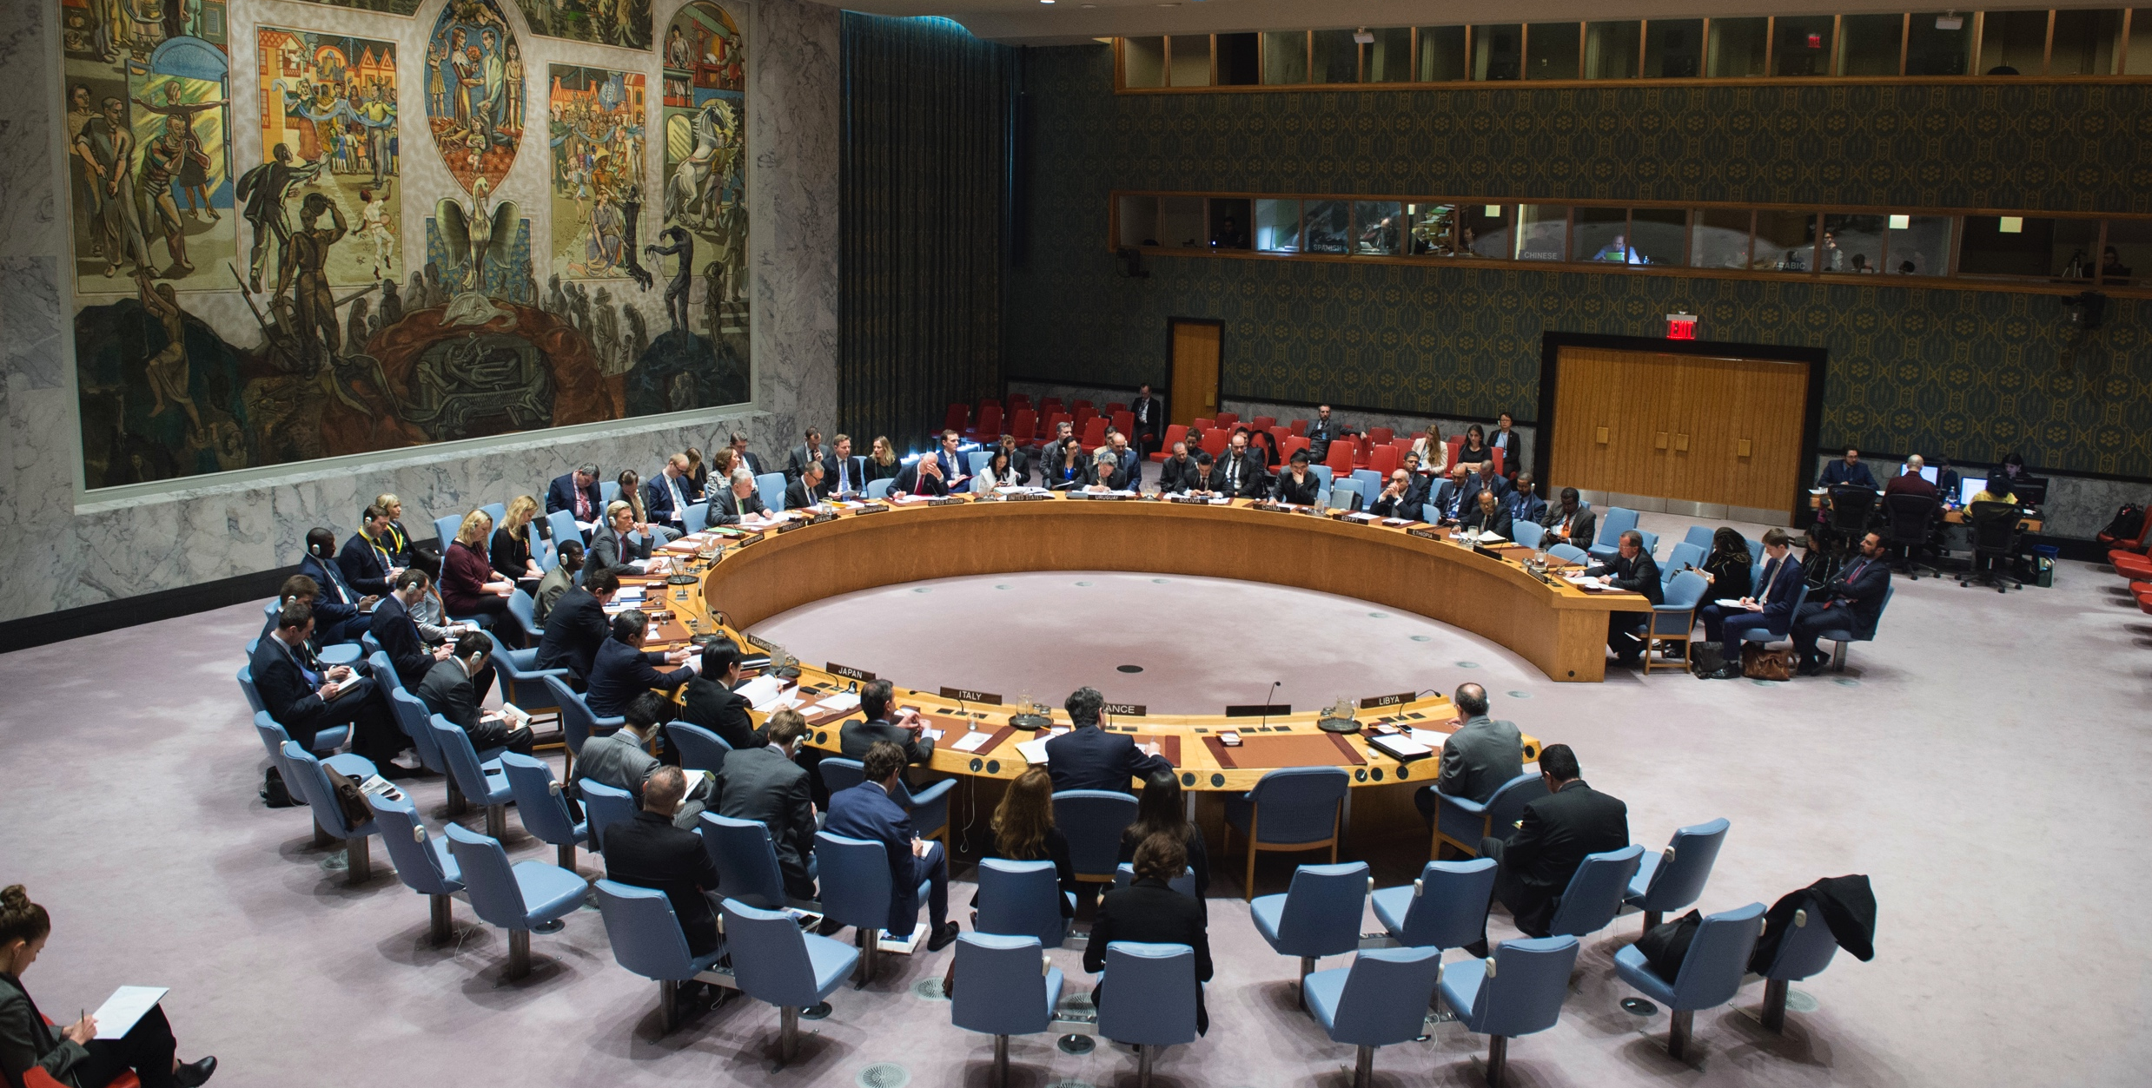
Security Council
GLOBAL CENTRE FOR THE RESPONSIBILITY TO PROTECT
UN Photo: Eskinder Debebe
Module 1: What is the “Responsibility to Protect?”
21

Slide 22
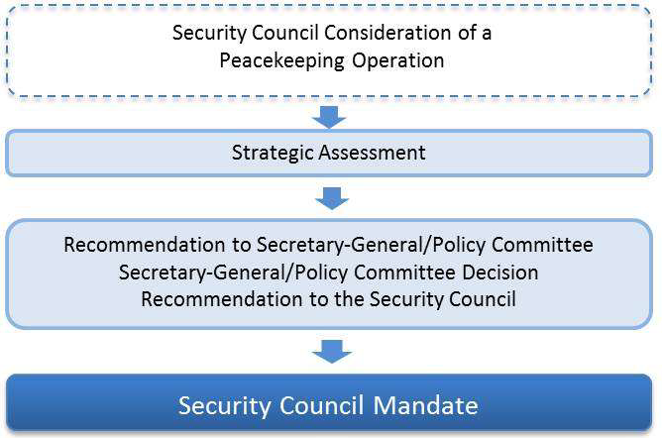
Security Council
GLOBAL CENTRE FOR THE RESPONSIBILITY TO PROTECT
Module 1: What is the “Responsibility to Protect?”
22

Slide 23
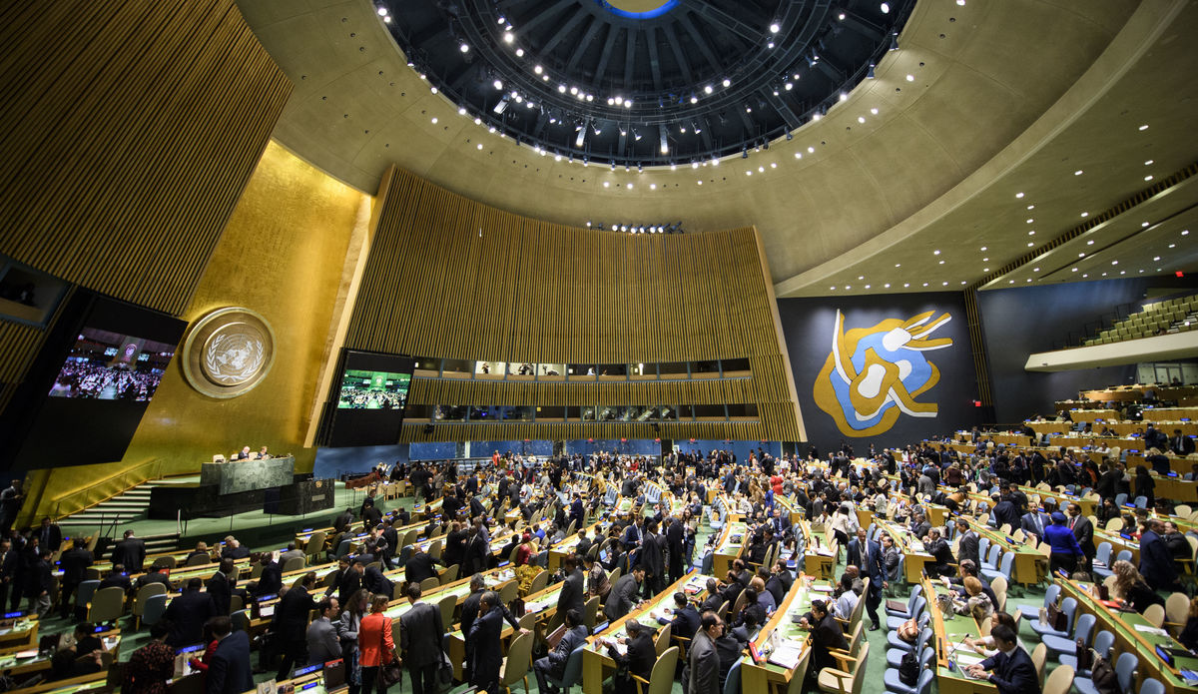
General Assembly
GLOBAL CENTRE FOR THE RESPONSIBILITY TO PROTECT
UN Photo: Manuel Elias
Module 1: What is the “Responsibility to Protect?”
23

Slide 24
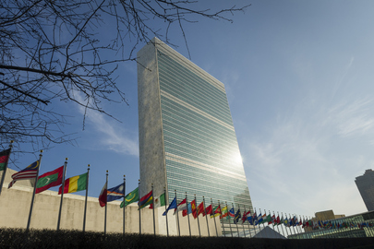
Secretariat
GLOBAL CENTRE FOR THE RESPONSIBILITY TO PROTECT
UN Photo: Rick Bajornas
Module 1: What is the “Responsibility to Protect?”
24

Slide 25
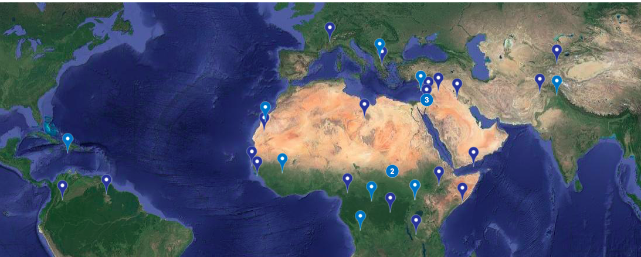
UN Missions and Mandates
GLOBAL CENTRE FOR THE RESPONSIBILITY TO PROTECT
4 types of missions: Traditional, Multidimensional, Transitional, Special Political
Module 1: What is the “Responsibility to Protect?”
25

Slide 26
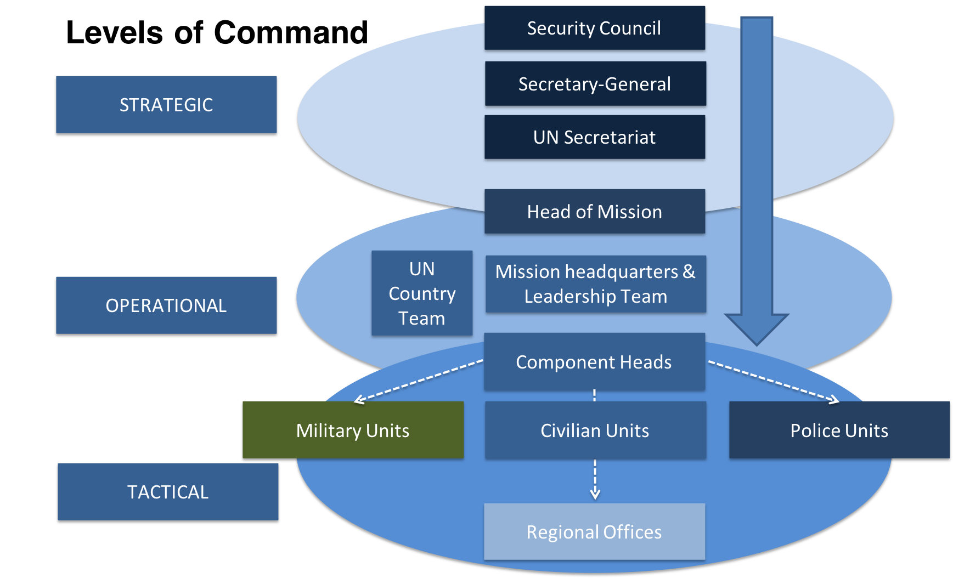
GLOBAL CENTRE FOR THE RESPONSIBILITY TO PROTECT
26
Module 1: What is the “Responsibility to Protect?”

Slide 27
Mission components include uniformed personnel as well as:
GLOBAL CENTRE FOR THE RESPONSIBILITY TO PROTECT
Civil Affairs
Political Affairs
Rule of Law/Judicial Affairs
SSR
DDR
JOC/JMAC
Public Information
Mission Support
DSRSG/RC/HC
SRSG’s Office
Women Protection Advisers
Child Protection Advisers
Gender Advisers
Module 1: What is the “Responsibility to Protect?”
27

Slide 28
Discussion Question:
Where does UN peacekeeping fit within R2P’s three pillars?
GLOBAL CENTRE FOR THE RESPONSIBILITY TO PROTECT
Module 1: What is the “Responsibility to Protect?”
28

Slide 29
Preambular paragraphs – pillar I:
GLOBAL CENTRE FOR THE RESPONSIBILITY TO PROTECT
As seen in similar mandates for: MINUSMA (Mali), AMISOM (Somalia), UNMISS (South Sudan), UNAMID (Darfur)
“recalling that the government of the DRC bears the primary responsibility to protect civilians within its territory and subject to its jurisdiction, including protection from crimes against humanity and war crimes”
UN Security Council Resolution 2348, MONUSCO (DRC)
“recalling that the CAR bears the primary responsibility to protect all populations within its territory from genocide, war crimes, ethnic cleansing and crimes against humanity”
UN Security Council Resolution 2399, MINUSCA (CAR)
Module 1: What is the “Responsibility to Protect?”
29

Slide 30
Preambular paragraphs – pillar II:
GLOBAL CENTRE FOR THE RESPONSIBILITY TO PROTECT
“reiterating its strong support for the Special Representative of the Secretary-General for Mali, and for MINUSMA to assist the Malian authorities and the Malian people in their efforts to bring lasting peace and stability to their country, bearing in mind the primary responsibility of the Malian authorities to protect the population”
UN Security Council Resolution 2374, MINUSMA (Mali)
Module 1: What is the “Responsibility to Protect?”
30

Slide 31
Operative paragraphs – pillar II:
GLOBAL CENTRE FOR THE RESPONSIBILITY TO PROTECT
“advising and assisting the Government of South Sudan, including military and police at national and local levels as appropriate, in fulfilling its responsibility to protect”
UN Security Council Resolution 1996, UNMISS (South Sudan)
Module 1: What is the “Responsibility to Protect?”
31

Slide 32
Preambular + Operative paragraphs – pillar III:
GLOBAL CENTRE FOR THE RESPONSIBILITY TO PROTECT
“reaffirming the primary responsibility of each State to protect”
“use all necessary means to carry out its mandate to protect civilians under imminent threat of physical violence, within its capabilities and its area of deployment, including to prevent the use of heavy weapons against the civilian population”
UN Security Council Resolution 1975, UNOCI (Cote d’Ivoire)
Module 1: What is the “Responsibility to Protect?”
32

Slide 33
Missions with Mandates Relevant to Upholding R2P:
GLOBAL CENTRE FOR THE RESPONSIBILITY TO PROTECT
In total, 7 missions have included a reference to the responsibility of states to uphold their responsibility to protect: MINUSCA (CAR), MINUSMA (Mali), MONUSCO (DRC), UNAMID (Darfur), UNMISS (South Sudan), UNOCI (Côte d’Ivoire; ended in 2017) and the AU Mission in Somalia (AMISOM)
UNMISS is mandated to monitor and report on incidents of hate speech
MONUSCO is mandated to assist the government in holding perpetrators of mass atrocity crimes accountable
Module 1: What is the “Responsibility to Protect?”
33

Slide 34
R2P and Other Protection Agendas
GLOBAL CENTRE FOR THE RESPONSIBILITY TO PROTECT
Conflict-Related Sexual Violence
Child Protection
Protection of Cultural Heritage
Module 1: What is the “Responsibility to Protect?”
34

Slide 35
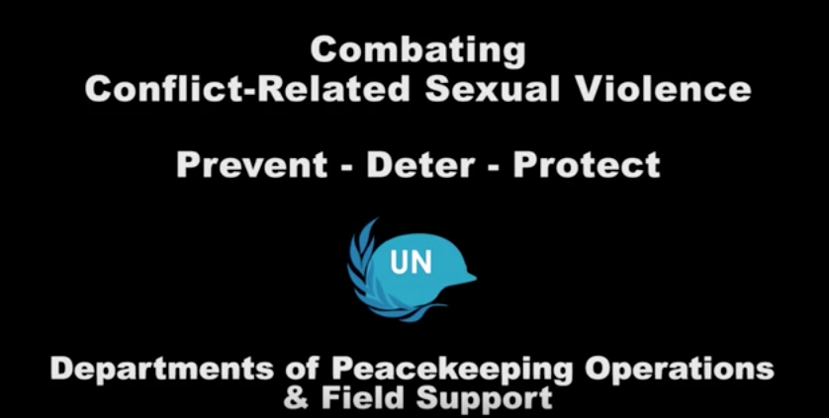
Conflict-Related Sexual Violence (CRSV)
GLOBAL CENTRE FOR THE RESPONSIBILITY TO PROTECT
“incidents or patterns of sexual violence that includes rape, sexual slavery, forced prostitution, forced pregnancy, enforced sterilization, or any other form of sexual violence of comparable gravity, against women, men, girls or boys“
Five missions have a specific mandate to combat CRSV: MINUSCA, MINUSMA, MONUSCO, UNAMID and UNMISS.
Module 1: What is the “Responsibility to Protect?”
35

Slide 36
Child Protection
GLOBAL CENTRE FOR THE RESPONSIBILITY TO PROTECT
UN peacekeepers are mandated to protect children from the “six grave violations” including:
  Killing and maiming
  Recruitment and use of child soldiers
  Abduction
  Rape and sexual violence
  Attacks against schools and hospitals
  Denial of humanitarian access
Module 1: What is the “Responsibility to Protect?”
36

Slide 37
Protection of Cultural Heritage
GLOBAL CENTRE FOR THE RESPONSIBILITY TO PROTECT
“…damage to cultural property belonging to any people whatsoever means damage to the cultural heritage of all mankind…” – Preamble, Convention for the Protection of Cultural Property in the Event of Armed Conflict (The Hague, 14 May 1954).
Intentional destruction of cultural heritage is often part of a wider and systematic effort by state or non-state actors to destroy a group and its history
Culture is an intrinsic part of what constitutes identity of a people and an attack on cultural heritage can consequently be seen as an attack on the very identity of a group and its right to exist
Mali hosts the one UN peacekeeping mission that was previously mandated to protect and restore cultural heritage (MINUSMA)
Module 1: What is the “Responsibility to Protect?”
37

Slide 38
Module 1 Learning Outcomes - Review
GLOBAL CENTRE FOR THE RESPONSIBILITY TO PROTECT
By the end of Module 1, learners will:
Explain R2P and the responsibilities it commits various actors to uphold
Understand the historic context of the development of R2P, including the grave consequences of failing to protect populations from mass atrocity crimes
Define the four mass atrocity crimes: war crimes, crimes against humanity, genocide, and ethnic cleansing
Identify the three pillars of R2P, list relevant actors for implementing each pillar, and describe different actions that can be taken by these actors under each pillar
Understand the basic structure of the United Nations, its organs and departments as it relates to peacekeeping
Understand the relationship between R2P and other protection agendas
Module 1: What is the “Responsibility to Protect?”
38
Module 1: What is the “Responsibility to Protect?”

